Slide 1
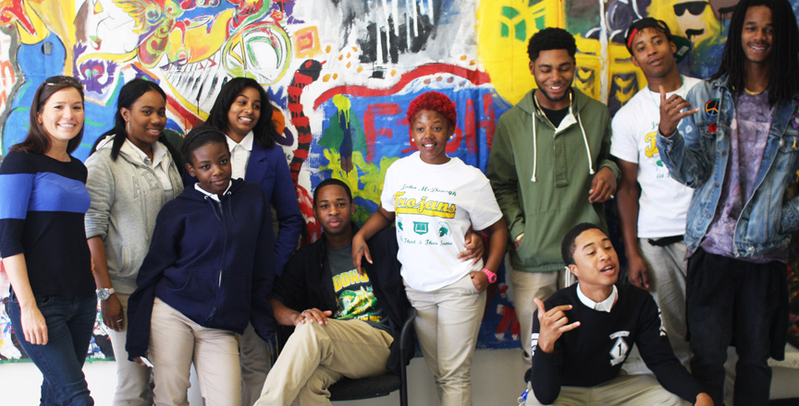
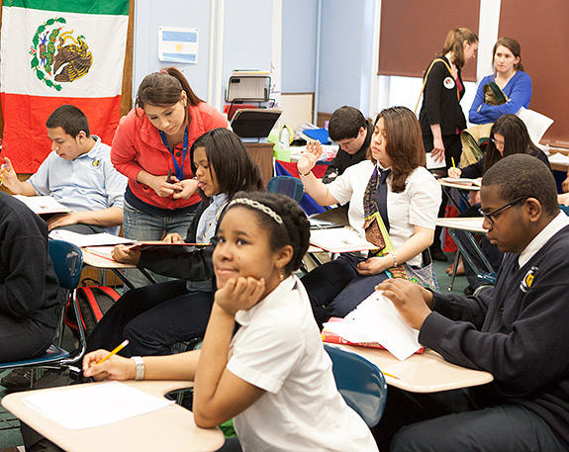
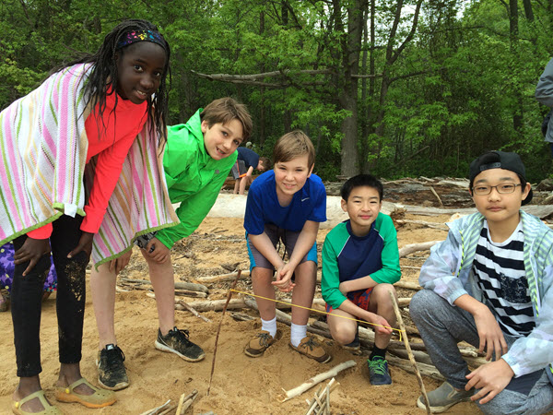
Reach Listen Learn Lead (RLLL)

Slide 2
Why we need “Reach, Listen, Learn, Lead”?
With a national discussion focused on how our country has become a more divided nation, a new opportunity opens up to reach out and understand each other. Whether it has been a divide between minority communities and law enforcement or rural and urban centers or political affiliation, this divide is unhealthy for the democracy of our nation. If we are willing to reach out and listen to others we can then learn and lead. President Obama said it so eloquently in his farewell address to the nation:

Slide 3
“That is what our Constitution and highest ideals require.
But laws alone won’t be enough. Hearts must change. It won’t change overnight. Social attitudes oftentimes take generations to change. But if our democracy is to work the way it should in this increasingly diverse nation, then each one of us need to try to heed the advice of a great character in American fiction, Atticus Finch, who said “You never really understand a person until you consider things from his point of view, until you climb into his skin and walk around in it.”…
So regardless of the station we occupy; we all have to try harder; we all have to start with the premise that each of our fellow citizens loves this country just as much as we do; that they value hard work and family just like we do; that their children are just as curious and hopeful and worthy of love as our own.”
President Barak Obama

Slide 4
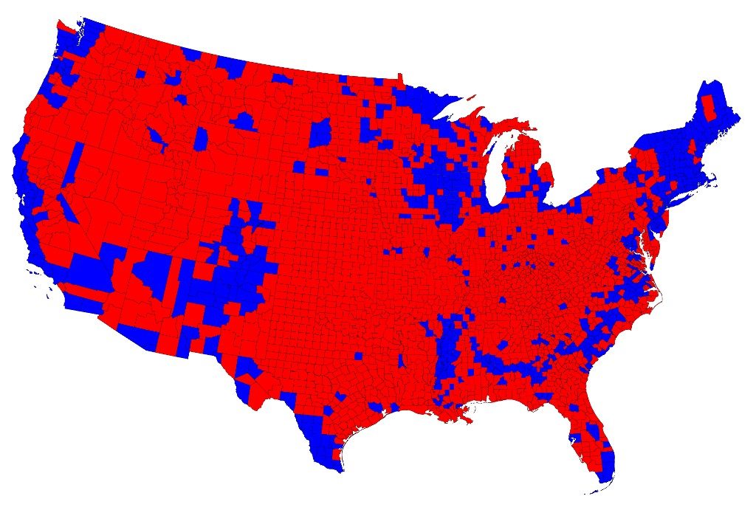
How do we turn this view of America into…

Slide 5
This view

Slide 6
Reach, Listen, Learn, Lead (RLLL)
The foundational principal: When we get to know others through exchange and inquiry, we are less likely to build walls and assume prejudices. Familiarity allows more understanding and tolerance of beliefs and norms that are different from our own.
This, in turn, develops far greater critical thinking skills which are needed for a strong and healthy democracy. As our young people become our future leaders these, skills must be developed and nurtured.
Reach, Listen, Learn, Lead will help develop these skills.

Slide 7
How does RLLL work ?
Step 1 – REACH
RLLL is modeled on foreign exchange programs and the Peace Corps World Wise School program. It’s aimed at middle and high school age students. It begins with a classroom or school being matched with a school of very different demographics.
School A (Urban)
School B (Outstate)
Race/Ethnicity | Count | Percent
Hispanic/Latino | 356 | 19.3%
American Indian/Alaska Native | 129 | 7.0%
Asian | 88 | 4.8%
Black/African American | 656 | 35.5%
Native Hawaiian/Pacific Islander | 1 | 0.1%
White | 608 | 32.9%
Two or More Races | 9 | 0.5%
All Students | 1,847 | 100.0%
Race/Ethnicity | Count | Percent
Hispanic/Latino | 14 | 3.3%
American Indian/Alaska Native | 23 | 5.4%
Asian | 3 | 0.7%
Black/African American | 10 | 2.4%
Native Hawaiian/Pacific Islander | 0 | 0.0%
White | 372 | 87.5%
Two or More Races | 3 | 0.7%
All Students | 425 | 100.0%

Slide 8
Step 2 – LISTEN (part one)
Once a classroom is matched, a very basic exchange begins
Each student puts together a one page bio of base information (pictures, favorite foods, hobbies, activities, movies, music, etc)
The students develop a list of base level questions to ask the other class/school focused on their school, town or city, climate of the area, etc.
Once this information is shared with each others schools
Online link created (Moodle, Schoology, Google, Skype, Facetime, etc.)
Classrooms would then make a once a week (preferred) commitment to connect with and learn about each other
This gives each student a chance to listen about the lives of others.

Slide 9
Step 2 - LISTEN (part 2)
After the two classes/schools have established a relationship the questions begin to go deeper.
What has shaped the community (ethnic and religious background, economics/job opportunities, etc.)?
What are the perceptions each others communities, who are their role models, and so on?
The students would be coached in advance about how to respectfully ask harder questions. The most important part of this dialogue would be listening to each other without making quick or unfounded judgments.

Slide 10
Step 3 - LEARN
Learning from each other requires inquiry and listening. However it can not end there. Real learning comes through reflection, debriefing, and guided discussions that will occur in their own classroom.
Critical role of the classroom teacher:
Listen to feedback of the students and be ready with deeper questions regarding what they are learning through the exchange.
Gently challenge their students when appropriate. Teachers then guide them in generating further questions or topics of discussion they would like to ask when the two classes next meet.

Slide 11
Step 4 – LEAD
RLLL participation, fosters future leaders through:
Opportunities to develop leadership skills
Strengthen ability to listen and understand differing point of views, even when they disagree.
Clearly articulate own ideas and point of view to others, maybe even strangers.
Becoming advocates for what is just and right
Developing empathy towards those they have not previously known
Example: Exchange ambassadors (beyond online)
Physical exchange between the two classes. “Ambassadors” could spend time in the other class/school/community learning first hand the culture of that community
Debrief what they have learned during this time with “home” students

Slide 12
Benefits and Outcomes of RLLL
State Standards in Social Studies, English/Language Arts, Writing, Fine Arts, Etc. (dependent on how the teachers personalize the exchange for their specific classroom/needs).
Students who will become the next generations leaders, will have developed a more positive sense about others who are different and help create a more inclusive society/ country as opposed to today's current direction.
Opportunities to go outside of the classroom (both virtually and physically) to learn from and about others, rather than making assumptions.
Opportunity to visit a new community and school and meet students and others they have only met previously on line, which has it’s limitations.
Students are given the chance to lift up their own culture, lifestyle, and teach others about who they are.
In reverse, students will learn about other cultures and viewpoints.

